Slide 1

Muhammad Umair Salim
28/04/2023
This is the Link for Github repo of this project

Slide 2

Outline
Executive Summary
Introduction
Methodology
Results
Conclusion
Appendix

Slide 3
Executive Summary
Methodology
Collected data from SpaceX API and by web scraping Wikipedia pages. After collecting data cleaned in and performed exploratory data analysis using SQL pandas and visualization libraries. Using the insights drawn by EDA further explored the data by interactive visualization and creating interactive dash dashboards for finding results. Finally completed the task of building a predictive classification model.
Results
Results were drawn from these three steps:
EDA
Interactive Visualization
Predictive Analysis
After drawing results they were then compiled into this report for purpose of presentation.

Slide 4

Introduction
SpaceX launches Falcon 9 rockets at a cost of around $62m. This is considerably cheaper than other providers (which usually cost upwards of $165m), and much of the savings are because SpaceX can land, and then re-use the first stage of the rocket.
If we can make predictions on whether the first stage will land, we can determine the cost of a launch, and use this information to assess whether or not an alternate company should bid and SpaceX for a rocket launch.
This project will ultimately predict if the Space X Falcon 9 first stage will land successfully.

Slide 5


Slide 6
Methodology Summery
Data Collection
Making GET requests to the SpaceX REST API
Web Scraping
Data Wrangling
Using the .fillna() method to remove NaN values
Using the .value_counts() method to determine the following:
Number of launches on each site
Number and occurrence of each orbit
Number and occurrence of mission outcome per orbit type
Creating a landing outcome label that shows the following:
0 when the booster did not land successfully
1 when the booster did land successfully
Exploratory Data Analysis
Using SQL queries to manipulate and evaluate the SpaceX dataset
Using Pandas and Matplotlib to visualize relationships between variables, and determine patterns
Interactive Visual Analytics
Geospatial analytics using Folium
Creating an interactive dashboard using Plotly Dash
Data Modelling and Evaluation
Using Scikit-Learn to:
Pre-process (standardize) the data
Split the data into training and testing data using train_test_split
Train different classification models
Find hyperparameters using GridSearchCV
Plotting confusion matrices for each classification model
Assessing the accuracy of each classification model
4. Interactive Visual Analytics
Geospatial analytics using Folium
Creating an interactive dashboard using Plotly Dash
5. Data Modelling and Evaluation
Using Scikit-Learn to:
Pre-process (standardize) the data
Split the data into training and testing data using train_test_split
Train different classification models
Find hyperparameters using GridSearchCV
Plotting confusion matrices for each classification model
Assessing the accuracy of each classification model

Slide 7
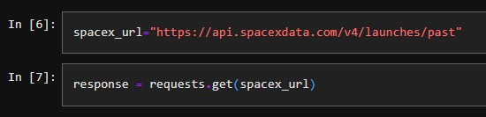
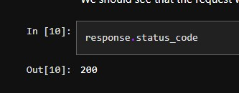
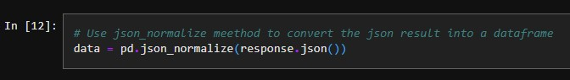
Data Collection – SpaceX API
Request (Space X APIs)
Filter data to only include Falcon 9 launches
Imputate missing PayloadMass values with mean
.JSON file + Lists(Launch Site, Booster Version, Payload Data)
Cast dictionary to a DataFrame
Json_normalize to DataFrame data from JSON
Dictionary relevant data
Github Link

Slide 8
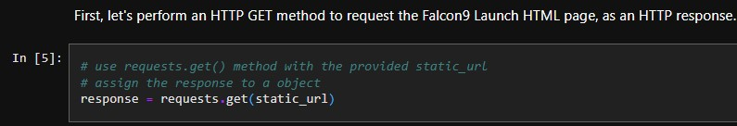
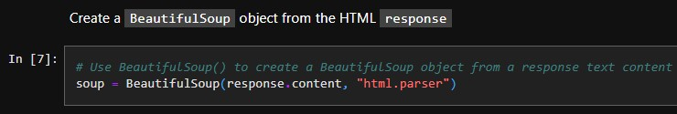
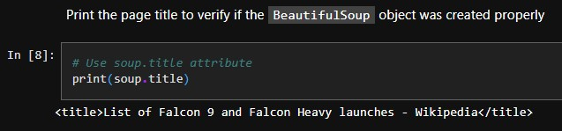
Data Collection – Scraping
Request Wikipedia
html
Cast dictionary to DataFrame
BeautifulSoup
html5lib Parser
Iterate through table cells to extract data to dictionary
Find launch info html table
Create dictionary
Github Link

Slide 9
Data Wrangling
Create a training label with landing outcomes where successful = 1 & failure = 0.
Outcome column has two components: ‘Mission Outcome’ ‘Landing Location’
New training label column ‘class’ with a value of 1 if ‘Mission Outcome’ is True and 0 otherwise. Value Mapping:
True ASDS, True RTLS, & True Ocean – set to -> 1
None None, False ASDS, None ASDS, False Ocean, False RTLS – set to -> 0
Github Link

Slide 10
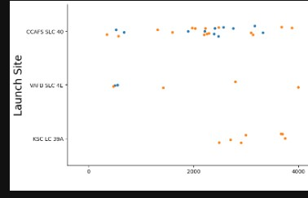
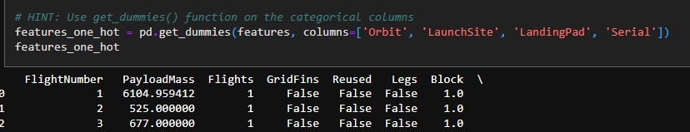
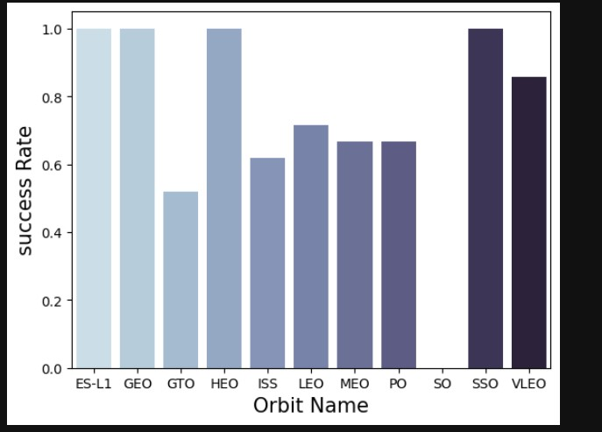
EDA with Data Visualization
Exploratory Data Analysis performed on variables Flight Number, Payload Mass, Launch Site, Orbit, Class and Year.
Plots Used:
Flight Number vs. Payload Mass, Flight Number vs. Launch Site, Payload Mass vs. Launch Site, Orbit vs. Success Rate, Flight Number vs. Orbit, Payload vs Orbit, and Success Yearly Trend
Scatter plots, line charts, and bar plots were used to compare relationships between variables to
decide if a relationship exists so that they could be used in training the machine learning model
Github Link

Slide 11
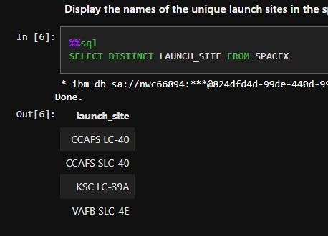
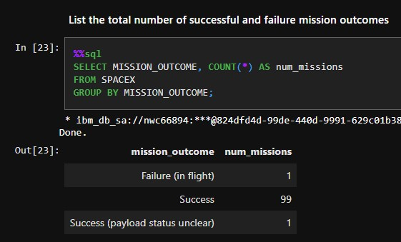
EDA with SQL
Loaded data set into IBM DB2 Database.
Queried using SQL Python integration.
Queries were made to get a better understanding of the dataset.
Queried information about launch site names, mission outcomes, various pay load sizes of customers and booster versions, and landing outcomes
Github Link

Slide 12
Build an Interactive Map with Folium
The following steps were taken to visualize the launch data on an interactive map:
Mark all launch sites on a map
Initialise the map using a Folium Map object
Add a folium.Circle and folium.Marker for each launch site on the launch map
Mark the success/failed launches for each site on a map
As many launches have the same coordinates, it makes sense to cluster them together.
Before clustering them, assign a marker colour of successful (class = 1) as green, and failed (class = 0) as red.
To put the launches into clusters, for each launch, add a folium.Marker to the MarkerCluster() object.
Create an icon as a text label, assigning the icon_color as the marker_colour determined previously.
Calculate the distances between a launch site to its proximities
To explore the proximities of launch sites, calculations of distances between points can be made using the Lat and Long values.
After marking a point using the Lat and Long values, create a folium.Marker object to show the distance.
To display the distance line between two points, draw a folium.PolyLine and add this to the map.
Github Link

Slide 13
Build a Dashboard with Plotly Dash
The following plots were added to a Plotly Dash dashboard to have an interactive visualisation of the data:
Pie chart (px.pie()) showing the total successful launches per site
This makes it clear to see which sites are most successful
The chart could also be filtered (using a dcc.Dropdown() object) to see the success/failure ratio for an individual site
Scatter graph (px.scatter()) to show the correlation between outcome (success or not) and payload mass (kg)
This could be filtered (using a RangeSlider() object) by ranges of payload masses
It could also be filtered by booster version
Github Link

Slide 14
Predictive Analysis (Classification)
Model Development
Model Evaluation
Finding the Best Classification Model
1
To prepare the dataset for model development:
Load dataset
Perform necessary data transformations (standardise and pre-process)
Split data into training and test data sets, using train_test_split()
Decide which type of machine learning algorithms are most appropriate
For each chosen algorithm:
Create a GridSearchCV object and a dictionary of parameters
Fit the object to the parameters
Use the training data set to train the model
For each chosen algorithm:
Using the output GridSearchCV object:
Check the tuned hyperparameters (best_params_)
Check the accuracy (score and best_score_)
Plot and examine the Confusion Matrix
Review the accuracy scores for all chosen algorithms
The model with the highest accuracy score is determined as the best performing model
Github Link

Slide 15
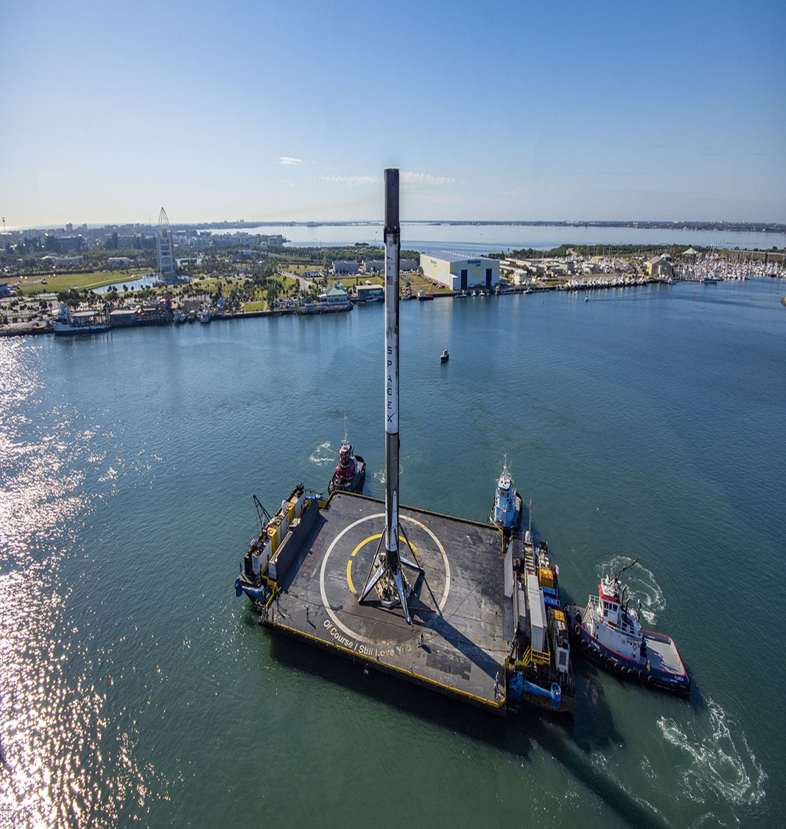
Results
Exploratory data analysis results
Interactive analytics demo in screenshots
Predictive analysis results

Slide 16
EDA with Visualization

Slide 17
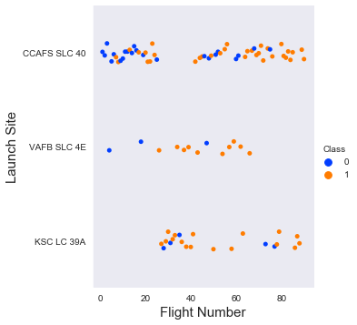
Flight Number vs. Launch Site
The scatter plot of Launch Site vs. Flight Number shows that:
As the number of flights increases, the rate of success at a launch site increases.
Most of the early flights (flight numbers < 30) were launched from CCAFS SLC 40, and were generally unsuccessful.
The flights from VAFB SLC 4E also show this trend, that earlier flights were less successful.
No early flights were launched from KSC LC 39A, so the launches from this site are more successful.
Above a flight number of around 30, there are significantly more successful landings (Class = 1).

Slide 18
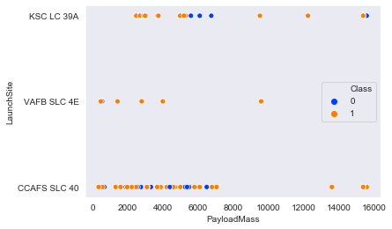
Payload vs. Launch Site
The screenshot of the scatter plot with explanation The scatter plot of Launch Site vs. Payload Mass shows that:
Above a payload mass of around 7000 kg, there are very few unsuccessful landings, but there is also far less data for these heavier launches.
There is no clear correlation between payload mass and success rate for a given launch site.
All sites launched a variety of payload masses, with most of the launches from CCAFS SLC 40 being comparatively lighter payloads (with some outliers).

Slide 19
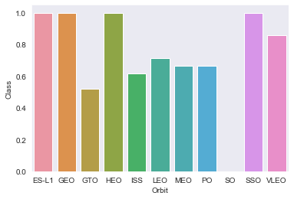
Success Rate vs. Orbit Type
The bar chart of Success Rate vs. Orbit Type shows that the following orbits have the highest (100%) success rate:
ES-L1 (Earth-Sun First Lagrangian Point)
GEO (Geostationary Orbit)
HEO (High Earth Orbit)
SSO (Sun-synchronous Orbit)
The orbit with the lowest (0%) success rate is:
SO (Heliocentric Orbit)

Slide 20
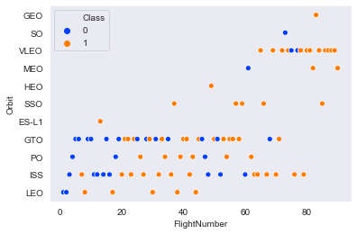
Flight Number vs. Orbit Type
This scatter plot of Orbit Type vs. Flight number shows a few useful things that the previous plots did not, such as:
The 100% success rate of GEO, HEO, and ES-L1 orbits can be explained by only having 1 flight into the respective orbits.
The 100% success rate in SSO is more impressive, with 5 successful flights.
There is little relationship between Flight Number and Success Rate for GTO.
Generally, as Flight Number increases, the success rate increases. This is most extreme for LEO, where unsuccessful landings only occurred for the low flight numbers (early launches).

Slide 21
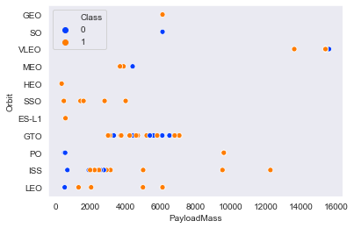
Pay Load Mass vs. Orbit Type
This scatter plot of Orbit Type vs. Payload Mass shows that:
The following orbit types have more success with heavy payloads:
PO (although the number of data points is small)
ISS
LEO
For GTO, the relationship between payload mass and success rate is unclear.
VLEO (Very Low Earth Orbit) launches are associated with heavier payloads, which makes intuitive sense.

Slide 22
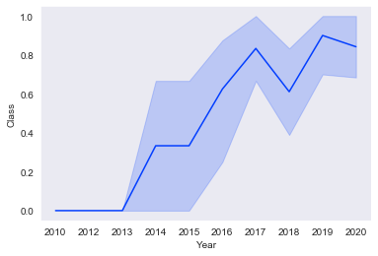
Launch Success Yearly Trend
The line chart of yearly average success rate shows that:
Between 2010 and 2013, all landings were unsuccessful (as the success rate is 0).
After 2013, the success rate generally increased, despite small dips in 2018 and 2020.
After 2016, there was always a greater than 50% chance of success.

Slide 23
EDA with SQL

Slide 24
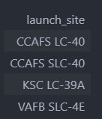
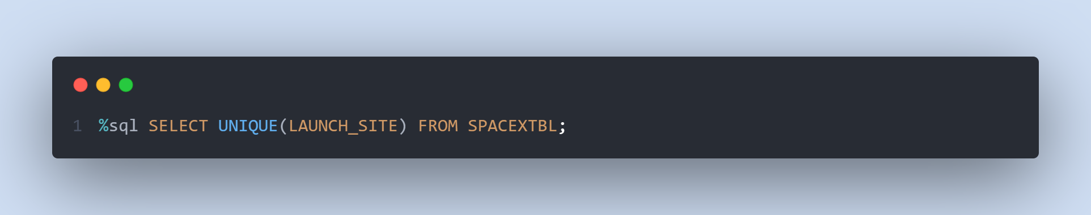
All Launch Site Names
Find the names of the unique launch sites.
The word UNIQUE returns only unique values from the LAUNCH_SITE column of the SPACEXTBL table.

Slide 25
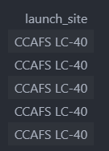
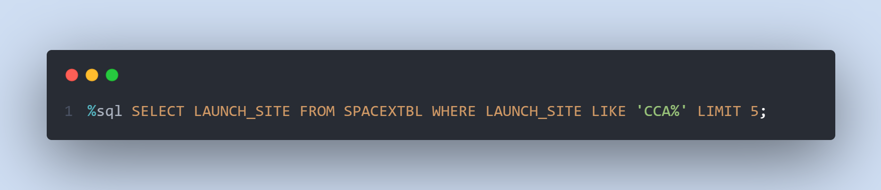
Launch Site Names Begin with 'CCA'
Find 5 records where launch sites begin with ‘CCA’.
LIMIT 5 fetches only 5 records, and the LIKE keyword is used with the wild card ‘CCA%’ to retrieve string values beginning with ‘CCA’.

Slide 26
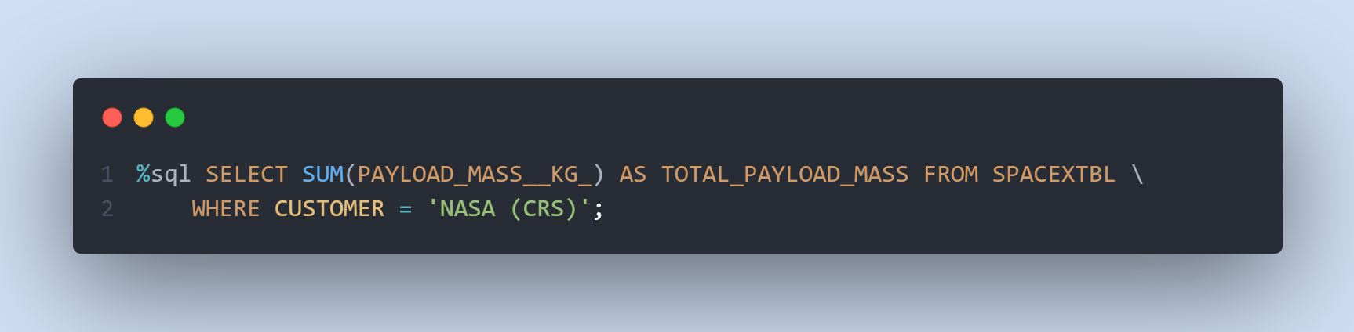
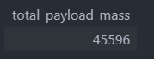
Total Payload Mass
Calculate the total payload carried by boosters from NASA.
The SUM keyword is used to calculate the total of the LAUNCH column, and the SUM keyword (and the associated condition) filters the results to only boosters from NASA (CRS).

Slide 27
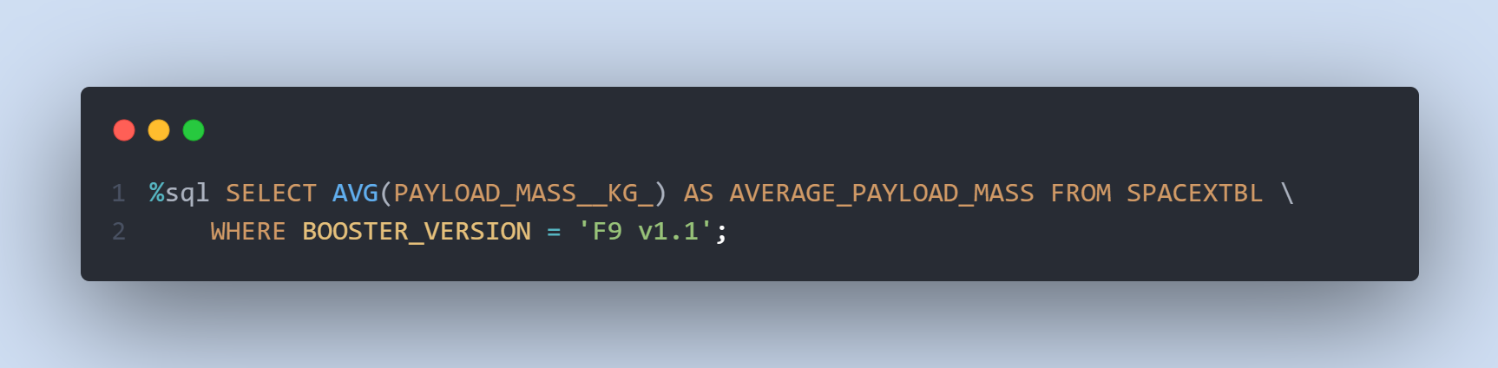
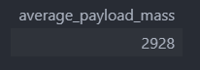
Average Payload Mass by F9 v1.1
Calculate the average payload mass carried by booster version F9 v1.1.
The AVG keyword is used to calculate the average of the PAYLOAD_MASS__KG_ column, and the WHERE keyword (and the associated condition) filters the results to only the F9 v1.1 booster version.

Slide 28
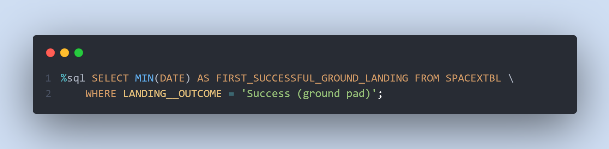
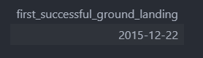
First Successful Ground Landing Date
Find the dates of the first successful landing outcome on ground pad.
The MIN keyword is used to calculate the minimum of the DATE column, i.e. the first date, and the WHERE keyword (and the associated condition) filters the results to only the successful ground pad landings.

Slide 29
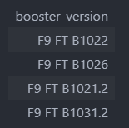
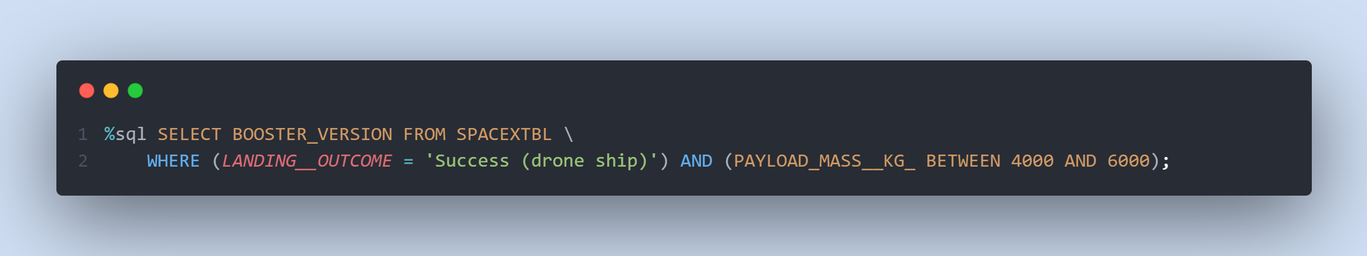
Successful Drone Ship Landing with Payload between 4000 and 6000
List the names of boosters which have successfully landed on drone ship and had payload mass greater than 4000 but less than 6000.
The WHERE keyword is used to filter the results to include only those that satisfy both conditions in the brackets (as the AND keyword is also used). The BETWEEN keyword allows for 4000 < x < 6000 values to be selected.

Slide 30
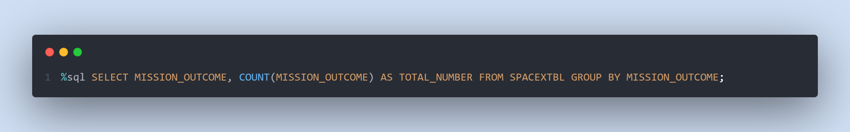
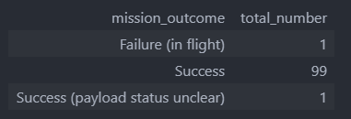
Total Number of Successful and Failure Mission Outcomes
Calculate the total number of successful and failure mission outcome.
The COUNT keyword is used to calculate the total number of mission outcomes, and the GROUPBY keyword is also used to group these results by the type of mission outcome.

Slide 31
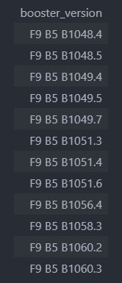
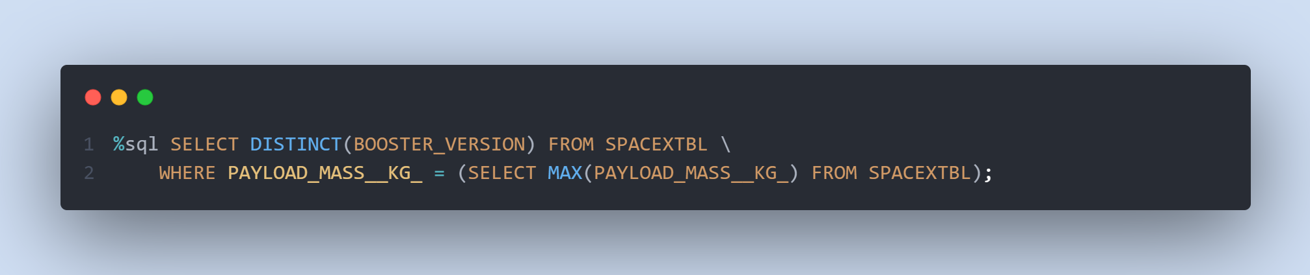
Boosters Carried Maximum Payload
List the names of the booster which have carried the maximum payload mass.
A subquery is used here. The SELECT statement within the brackets finds the maximum payload, and this value is used in the WHERE condition. The DISTINCT keyword is then used to retrieve only distinct /unique booster versions.

Slide 32
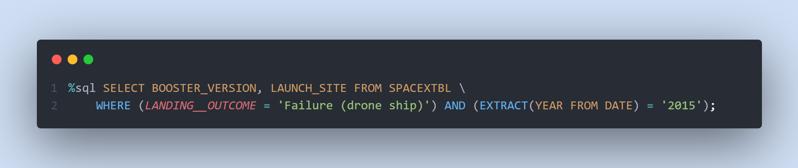
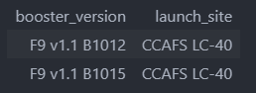
2015 Launch Records
List the failed landing_outcomes in drone ship, their booster versions, and launch site names for in year 2015.
The WHERE keyword is used to filter the results for only failed landing outcomes, AND only for the year of 2015.

Slide 33
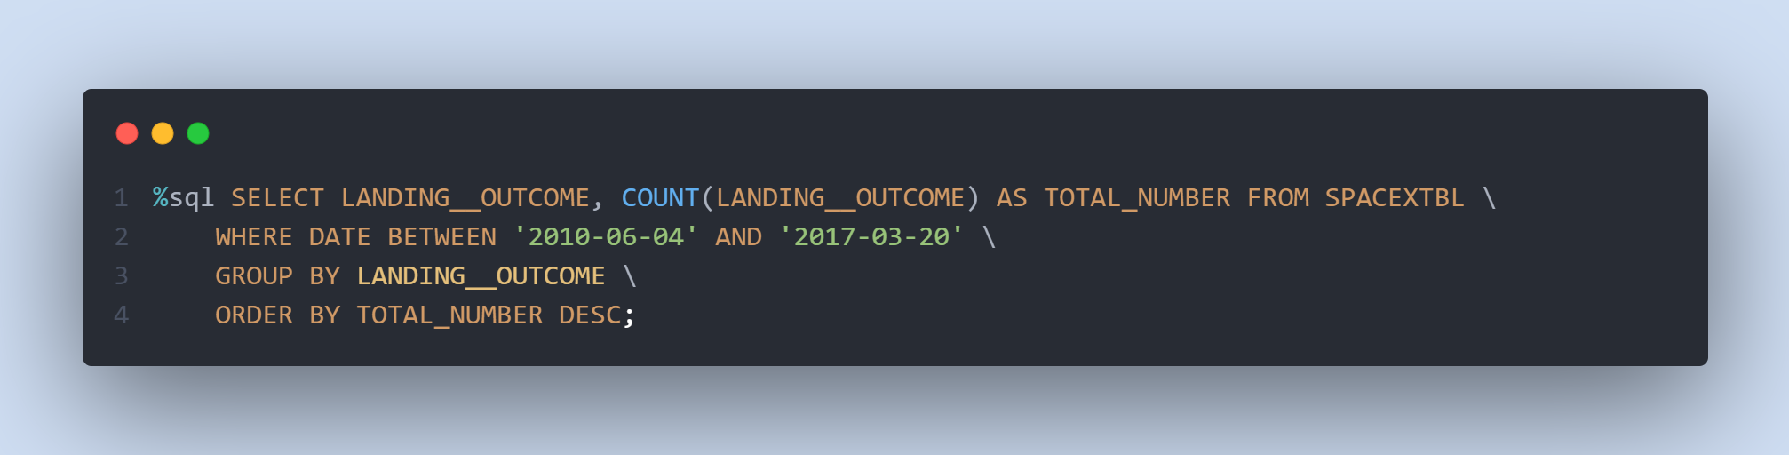
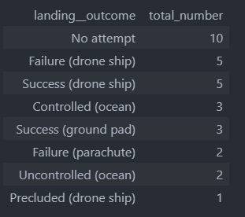
Rank Landing Outcomes Between 2010-06-04 and 2017-03-20
Rank the count of landing outcomes (such as Failure (drone ship) or Success (ground pad)) between the date 2010-06-04 and 2017-03-20, in descending order.
The WHERE keyword is used with the BETWEEN keyword to filter the results to dates only within those specified. The results are then grouped and ordered, using the keywords GROUP BY and ORDER BY, respectively, where DESC is used to specify the descending order.

Slide 34
LAUNCH SITES PROXIMITY ANALYSIS – FOLIUM INTERACTIVE MAP

Slide 35




LAUNCH SITES PROXIMITY ANALYSIS – FOLIUM INTERACTIVE MAP
All SpaceX launch sites are on coasts of the United States of America, specifically Florida and California.

Slide 36






SUCCESS/FAILED LAUNCHES FOR EACH SITE
CCAFS SLC-40 and CCAFS LC-40
VAFB SLC-4E
KSC LC-39A
$$=$$

Slide 37
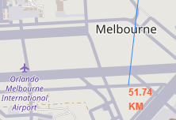
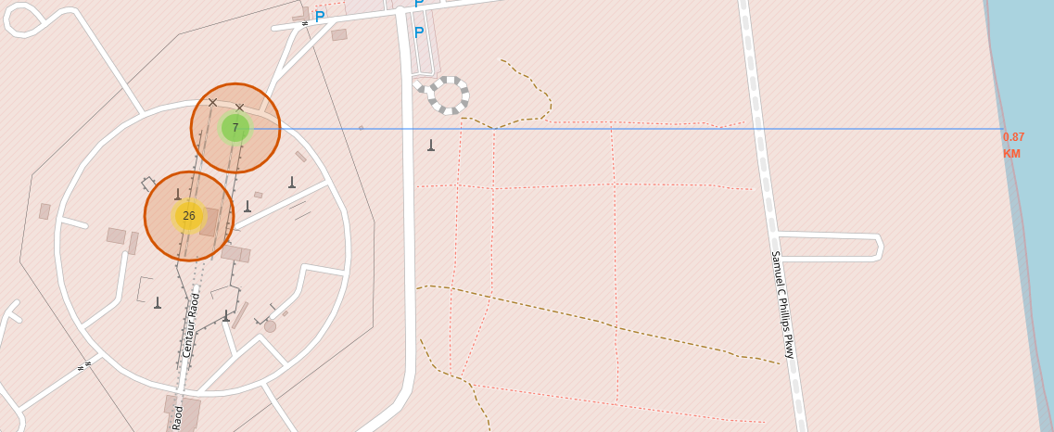
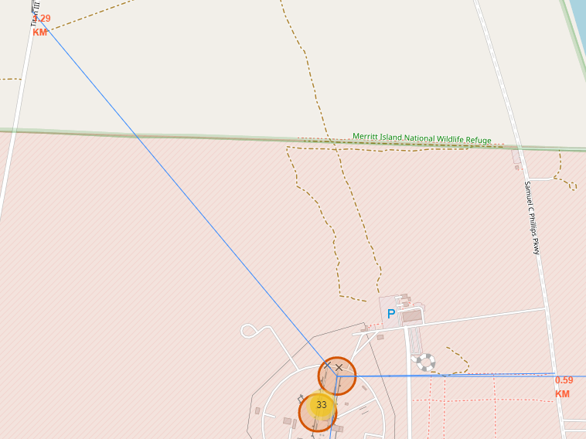
PROXIMITY OF LAUNCH SITES TO OTHER POINTS OF INTEREST
Using the CCAFS SLC-40 launch site as an example site, we can understand more about the placement of launch sites.
Are launch sites in close proximity to railways?
YES. The coastline is only 0.87 km due East.
Are launch sites in close proximity to highways?
YES. The nearest highway is only 0.59km away.
Are launch sites in close proximity to railways?
YES. The nearest railway is only 1.29 km away.
Do launch sites keep certain distance away from cities?
YES. The nearest city is 51.74 km away.

Slide 38
interactive dashboard - Plotly Dash

Slide 39

launch success count for all sites
The launch site KSC LC-39 A had the most successful launches, with 41.7% of the total successful launches.

Slide 40

Pie chart for the launch site with highest launch success ratio
The launch site KSC LC-39 A also had the highest rate of successful launches, with a 76.9% success rate.

Slide 41

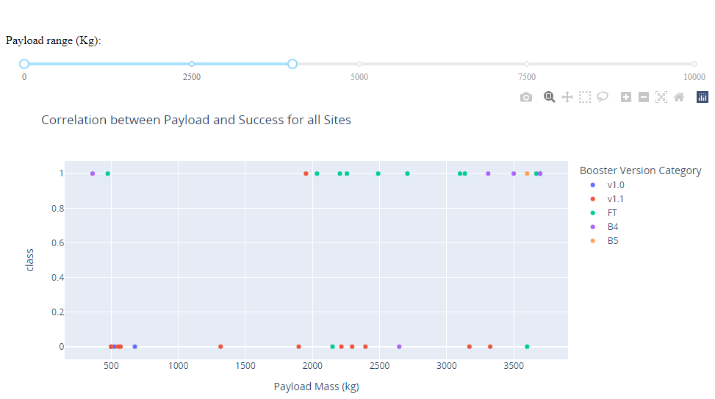
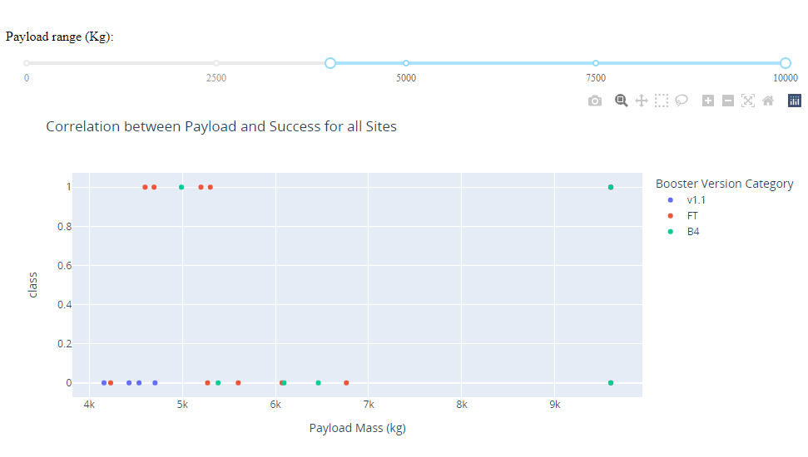
Launch Outcome VS. Payload scatter plot for all sites
1
1
Low payloads
2
Massive payloads
2
Plotting the launch outcome vs. payload for all sites shows a gap around 4000 kg, so it makes sense to split the data into 2 ranges:
0 – 4000 kg (low payloads)
4000 – 10000 kg (massive payloads)
From these 2 plots, it can be shown that the success for massive payloads is lower than that for low payloads.
It is also worth noting that some booster types (v1.0 and B5) have not been launched with massive payloads.

Slide 42
PREDICTIVE ANALYSIS - CLASSIFICATION

Slide 43
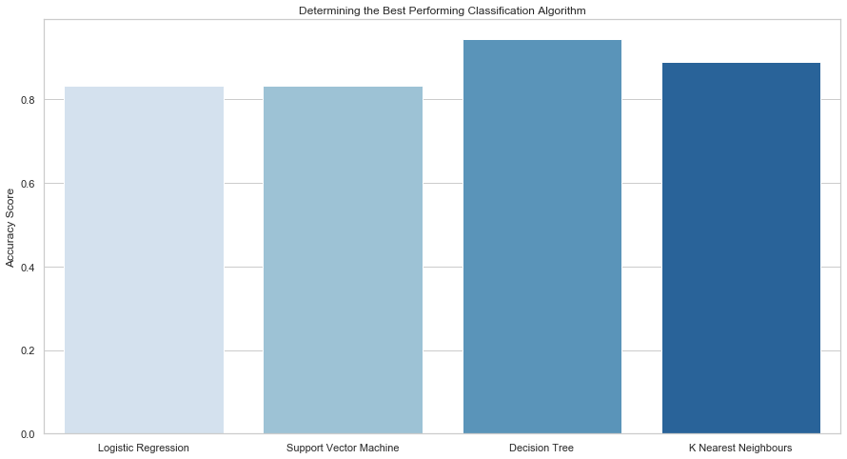
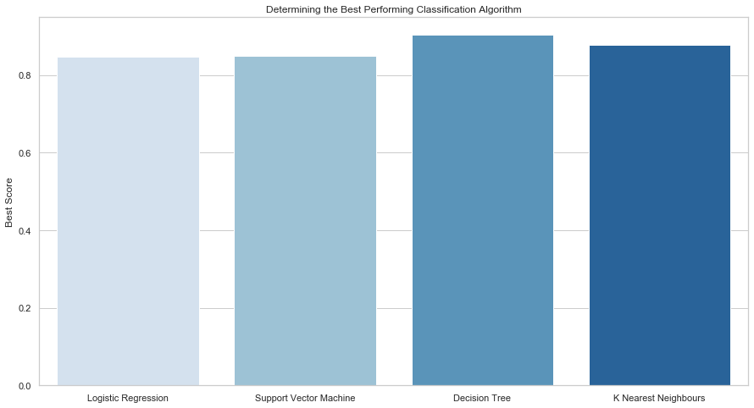
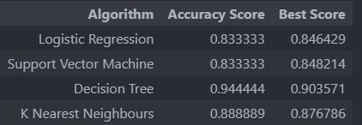
Classification Accuracy
Plotting the Accuracy Score and Best Score for each classification algorithm produces the following result:
The Decision Tree model has the highest classification accuracy
The Accuracy Score is 94.44%
The Best Score is 90.36%

Slide 44
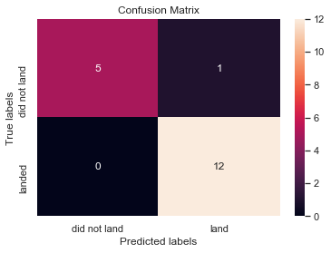
Confusion Matrix
As shown previously, best performing classification model is the Decision Tree model, with an accuracy of 94.44%.
This is explained by the confusion matrix, which shows only 1 out of 18 total results classified incorrectly (a false positive, shown in the top-right corner).
The other 17 results are correctly classified (5 did not land, 12 did land).

Slide 45
CONCLUSIONS

Slide 46
CONCLUSIONS
As the number of flights increases, the rate of success at a launch site increases, with most early flights being unsuccessful. I.e. with more experience, the success rate increases.
Between 2010 and 2013, all landings were unsuccessful (as the success rate is 0).
After 2013, the success rate generally increased, despite small dips in 2018 and 2020.
After 2016, there was always a greater than 50% chance of success.
Orbit types ES-L1, GEO, HEO, and SSO, have the highest (100%) success rate.
The 100% success rate of GEO, HEO, and ES-L1 orbits can be explained by only having 1 flight into the respective orbits.
The 100% success rate in SSO is more impressive, with 5 successful flights.
The orbit types PO, ISS, and LEO, have more success with heavy payloads:
VLEO (Very Low Earth Orbit) launches are associated with heavier payloads, which makes intuitive sense.
The launch site KSC LC-39 A had the most successful launches, with 41.7% of the total successful launches, and also the highest rate of successful launches, with a 76.9% success rate.
The success for massive payloads (over 4000kg) is lower than that for low payloads.
The best performing classification model is the Decision Tree model, with an accuracy of 94.44%.

Slide 47
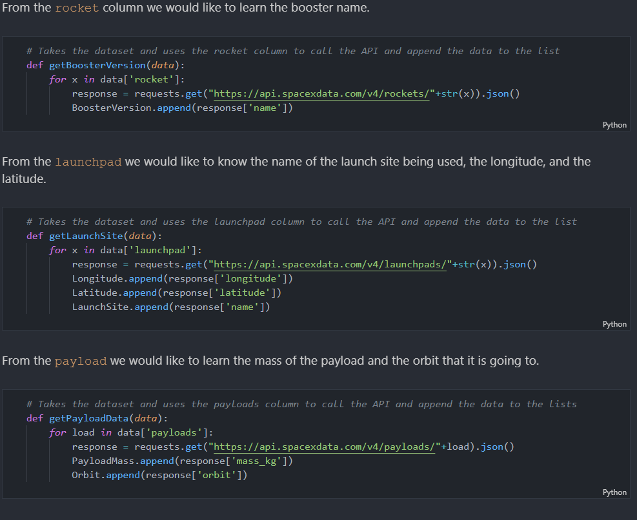
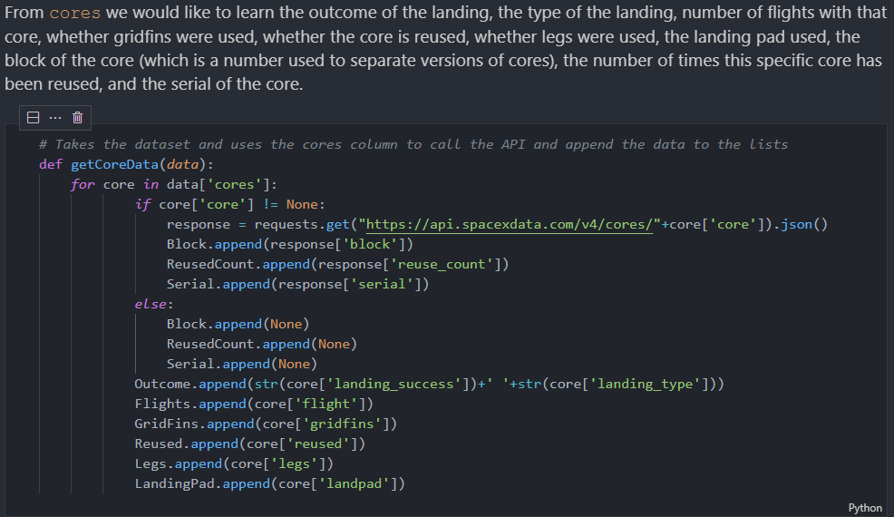
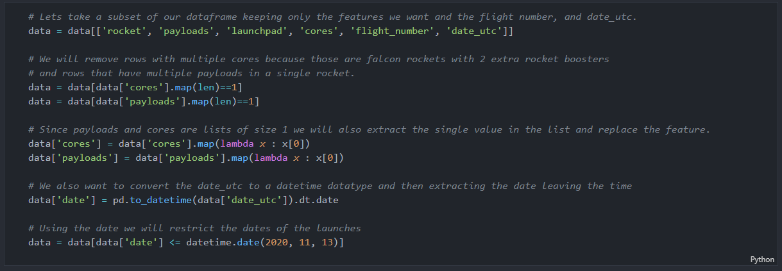
Appendix
DATA COLLECTION – space x REST api
Custom functions to retrieve the required information
Custom logic to clean the data

Slide 48


Appendix
DATA COLLECTION – WEB SCRAPING
Custom functions for web scraping
Custom logic to fill up the launch_dict values with values from the launch tables

Slide 49


